Slide 1
More “Fun with JOINs” . Scenarios and Queries

Slide 2
Scenario One: We are doing an audit for FY 2011-12. I need a listing of all of our customer orders, by Customer Company Name, Account Rep Name, Date of the order, and Date of Shipping. I need this in two lists: The first list in chronological order, from the most recent Order date. The second list in chronological order, from the oldest Order date.

Slide 3
Join to the world
select CompanyName as 'Customer Account', FirstName + ' ' + LastName as 'Account Rep', OrderDate, ShipDate
from Customer as C
Join employee as E
ON E.EmpNo = C.AcctRepNo
join CustomerOrder as O
ON
C.CustNo = O.CustNo
Where OrderDate BETWEEN '2011-01-01' AND '2012-12-31'
Order by Orderdate DESC

Slide 4
Customer Account Account Rep OrderDate ShipDate
---------------------------------------- ------------------------------------ ---------- ----------
Major League Sports Amy Boyle 2012-06-30 2012-07-05
Foster Sports Supply Amy Boyle 2012-06-19 2012-06-21
Fred's Funtime Amy Boyle 2012-05-30 2012-06-02
The Sports Shoppe Leonard Melice 2012-05-15 2012-05-19
JRG Enterprises David Teeter 2012-05-15 2012-05-22
Ralph's Outdoor Emporium Kay Riddle 2012-05-02 2012-05-05
Two Guys & A Gal Fitness Center Leonard Melice 2012-05-01 2012-05-03
Sports World David Teeter 2012-04-17 2012-04-20
Score-4 Sports Kay Riddle 2012-03-30 2012-04-03
JRG Enterprises David Teeter 2012-03-20 2012-03-23
Major League Sports Amy Boyle 2012-03-03 2012-03-07
Fred's Funtime Amy Boyle 2012-03-01 2012-03-03
Sports World David Teeter 2012-02-20 2012-02-24
Ralph's Outdoor Emporium Kay Riddle 2012-01-31 2012-02-03
Score-4 Sports Kay Riddle 2012-01-23 2012-01-25
Major League Sports Amy Boyle 2012-01-06 2012-01-12
Fred's Funtime Amy Boyle 2011-12-20 2011-12-22
Sports World David Teeter 2011-12-05 2011-12-08
P & T Entertainment David Teeter 2011-11-21 2011-11-28
Ralph's Outdoor Emporium Kay Riddle 2011-11-18 2011-11-22
Fred's Funtime Amy Boyle 2011-10-31 2011-11-04
Turner Sporting Goods Kay Riddle 2011-10-21 2011-10-26
Sports World David Teeter 2011-09-29 2011-10-03
P & T Entertainment David Teeter 2011-08-31 2011-09-05
Ralph's Outdoor Emporium Kay Riddle 2011-08-15 2011-08-19
P & T Entertainment David Teeter 2011-08-01 2011-08-04
Turner Sporting Goods Kay Riddle 2011-07-29 2011-08-02
Ralph's Outdoor Emporium Kay Riddle 2011-07-15 2011-07-22
Turner Sporting Goods Kay Riddle 2011-06-09 2011-06-13
Turner Sporting Goods Kay Riddle 2011-05-11 2011-05-16
(30 rows affected)

Slide 5
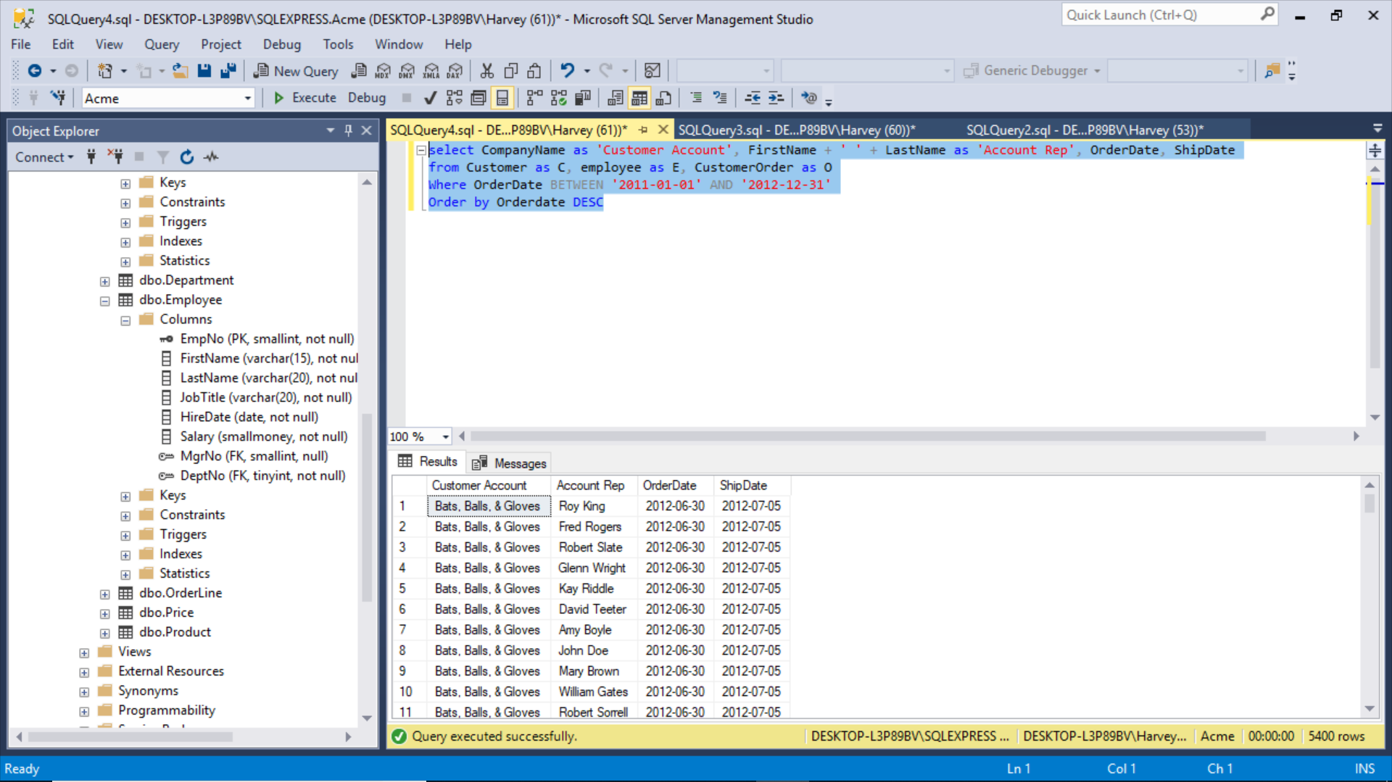
Without the Join, SQL Server gives you this mess:

Slide 6
Scenario Two: I need a list of the order numbers and order dates, with the total sales amount for each order and the Sales Rep for the order, for the entire year of 2011. I need it sorted from highest to lowest sales amount. Wait, damn it, we don’t have a column for “SalesRep.” Well you are fired!

Slide 7
So I faked it. I added an FK “SalesRep” to the CustomerOrder Table. Then I added some “fake news” SalesRep data.

Slide 8
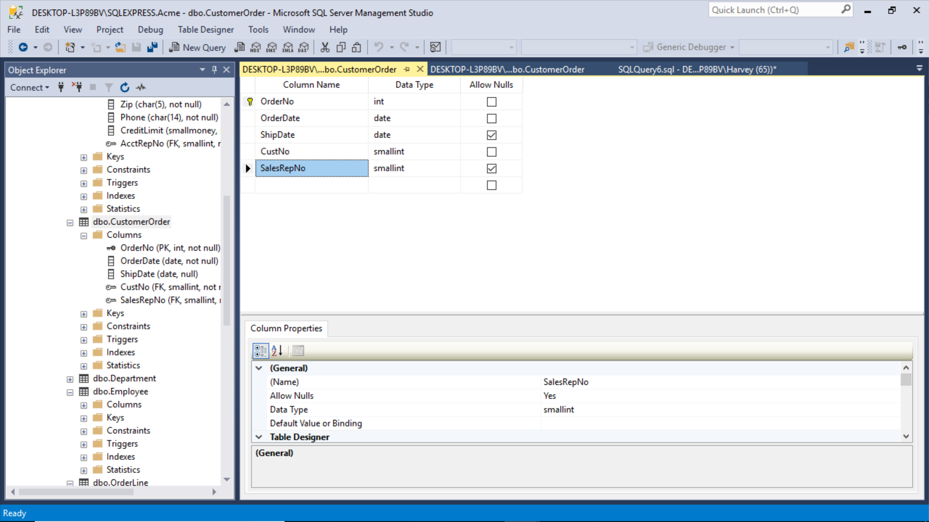
I added this column. Now I will declare it as my FK and link it to the PK table I want to reference.
New column

Slide 9
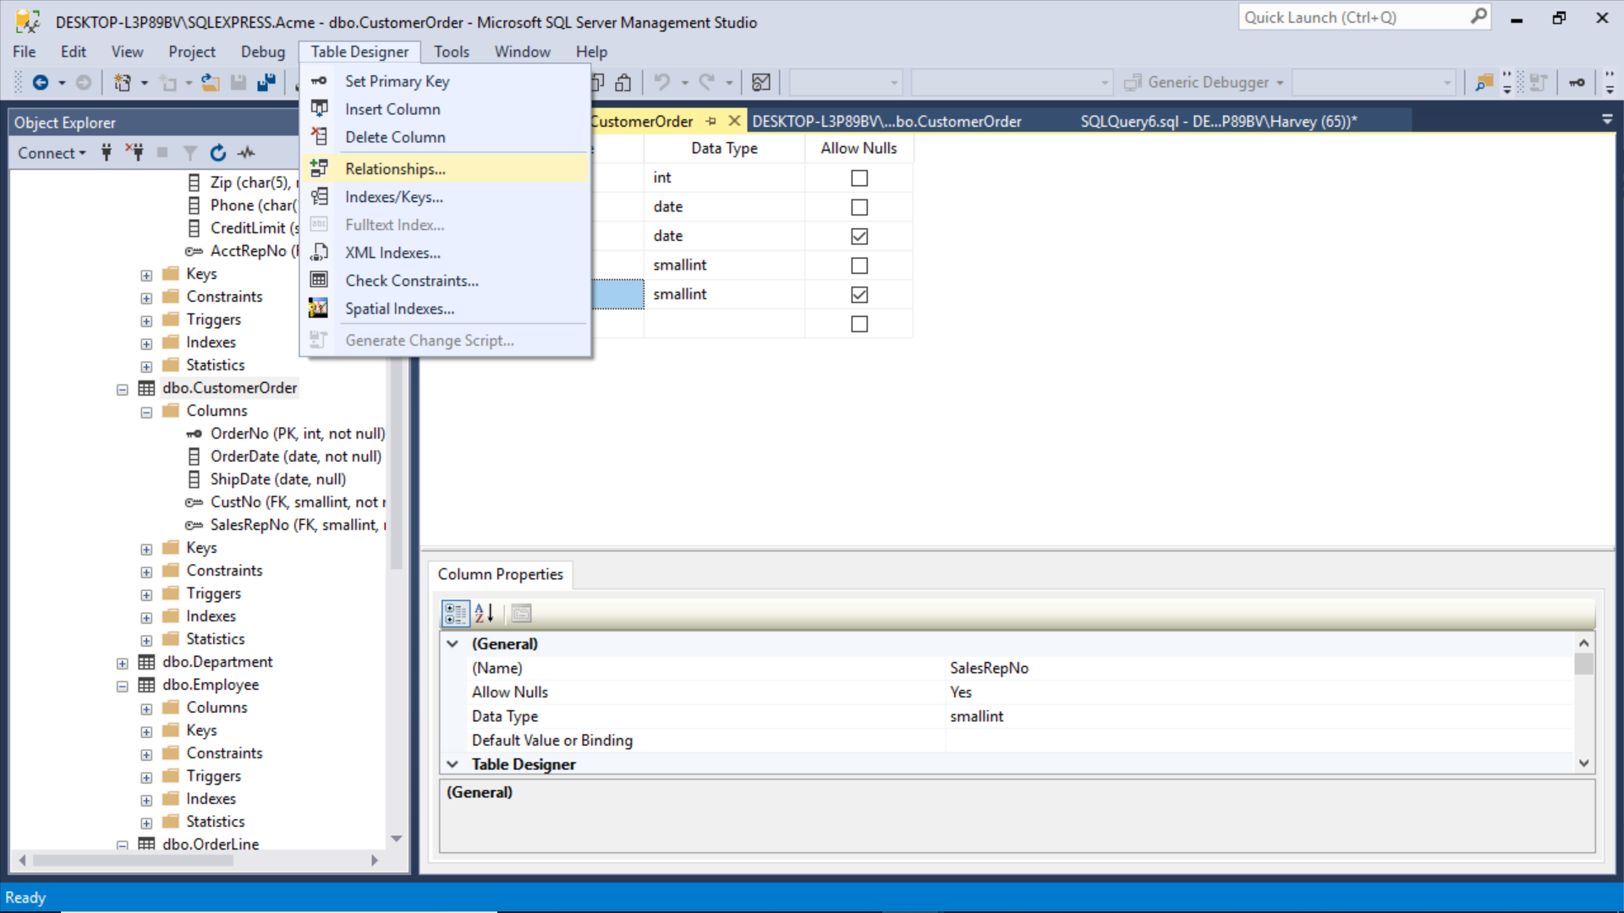

Slide 10
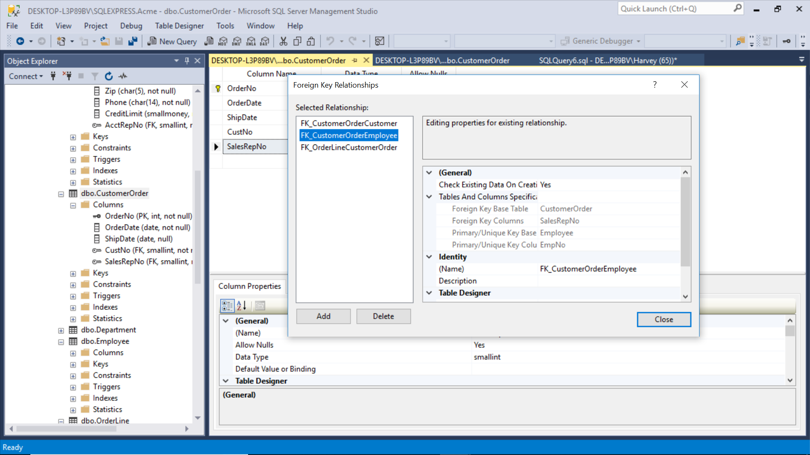

Slide 11
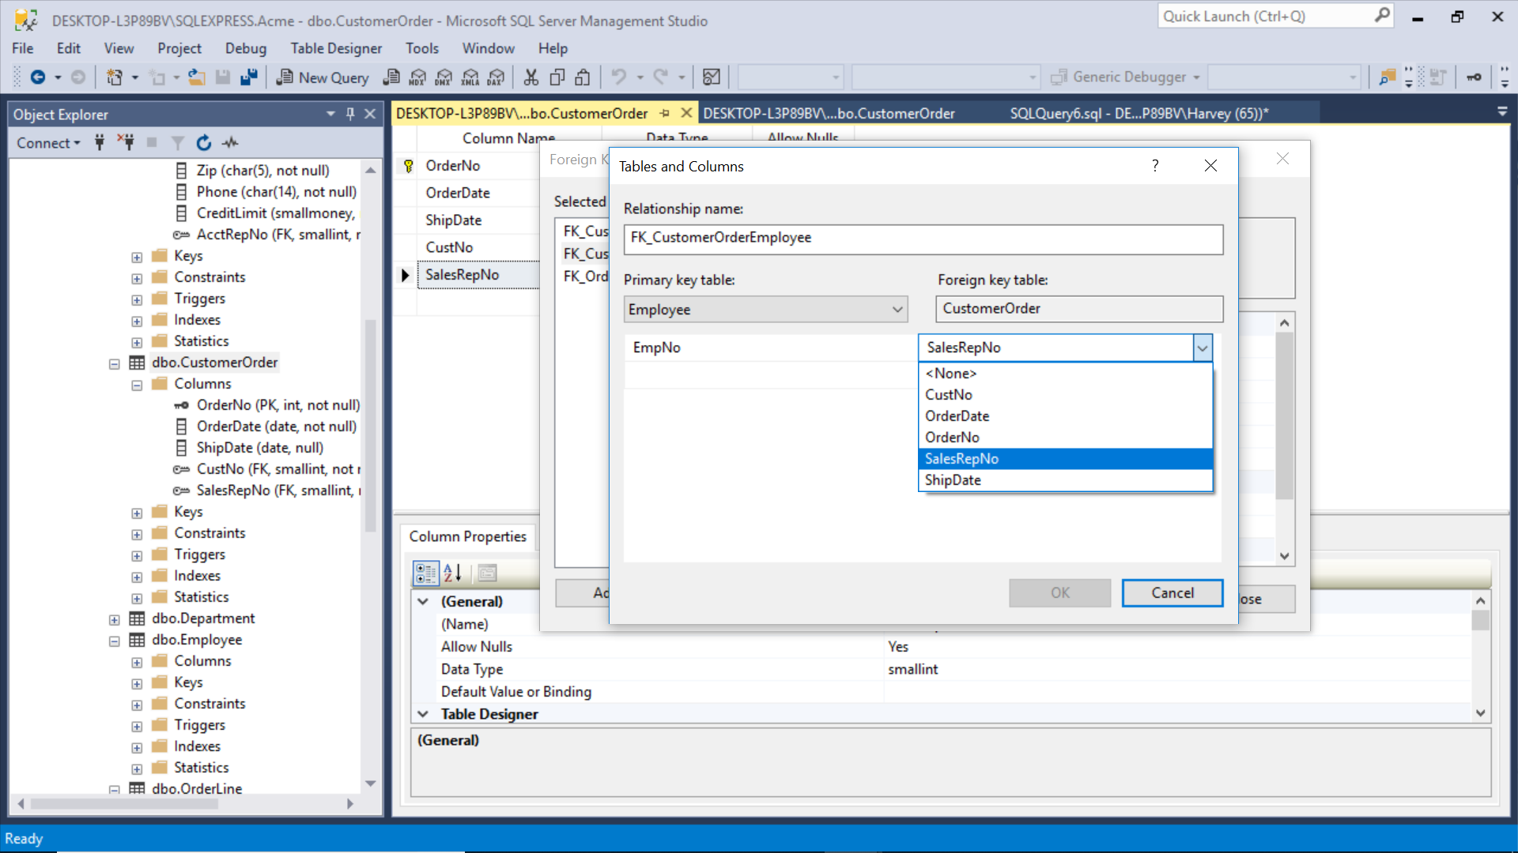
Remember, I am working in the FK table, pointing back to the PK table

Slide 12
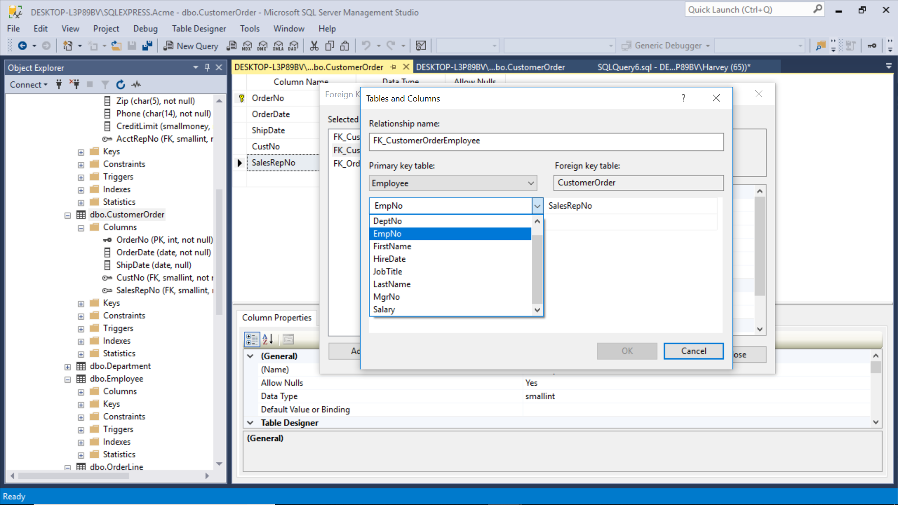

Slide 13
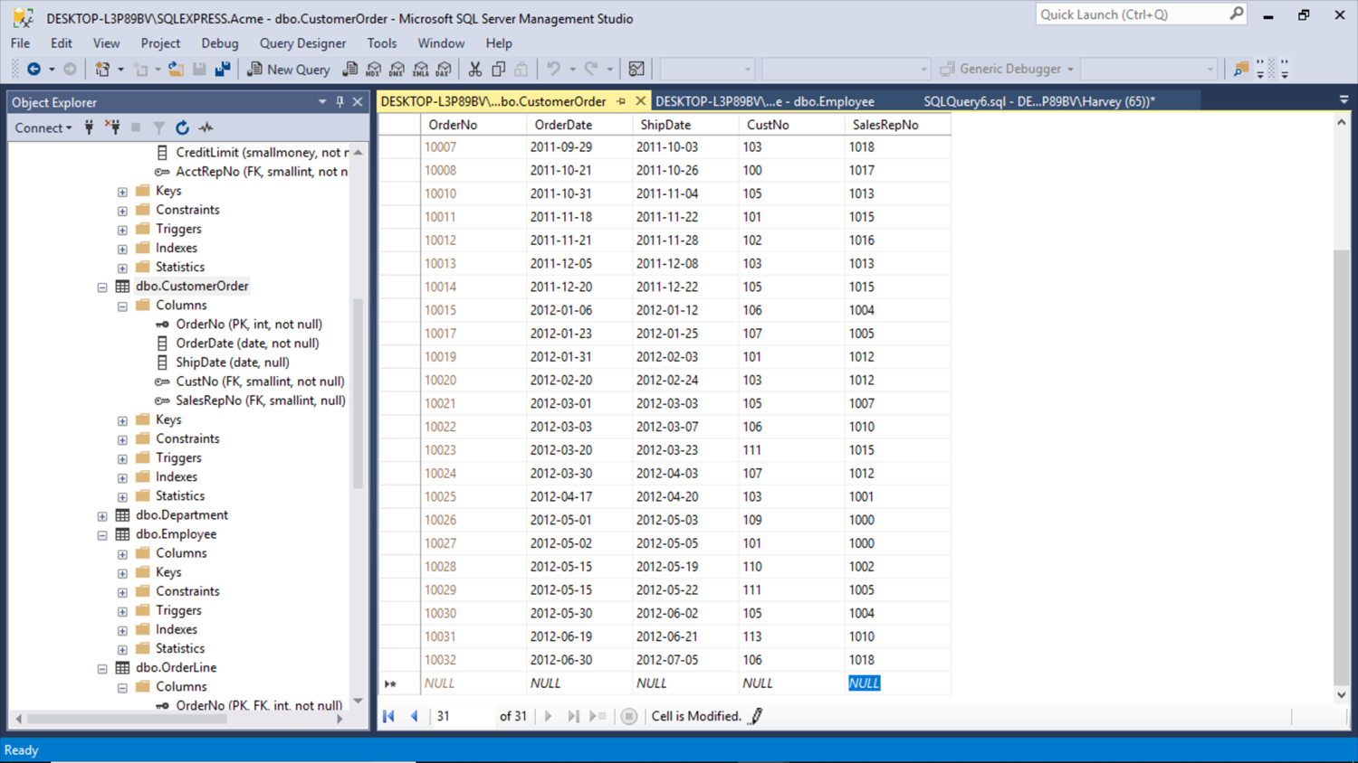
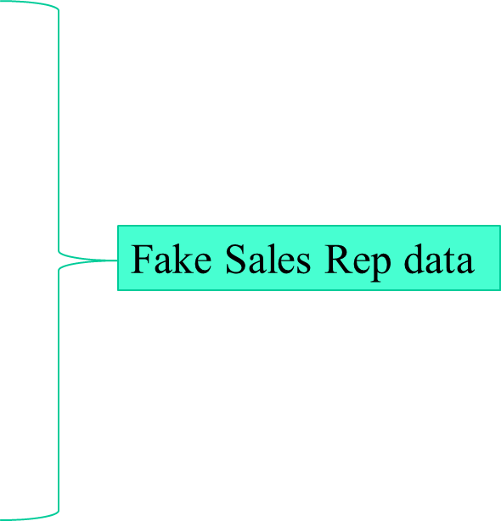

Slide 14
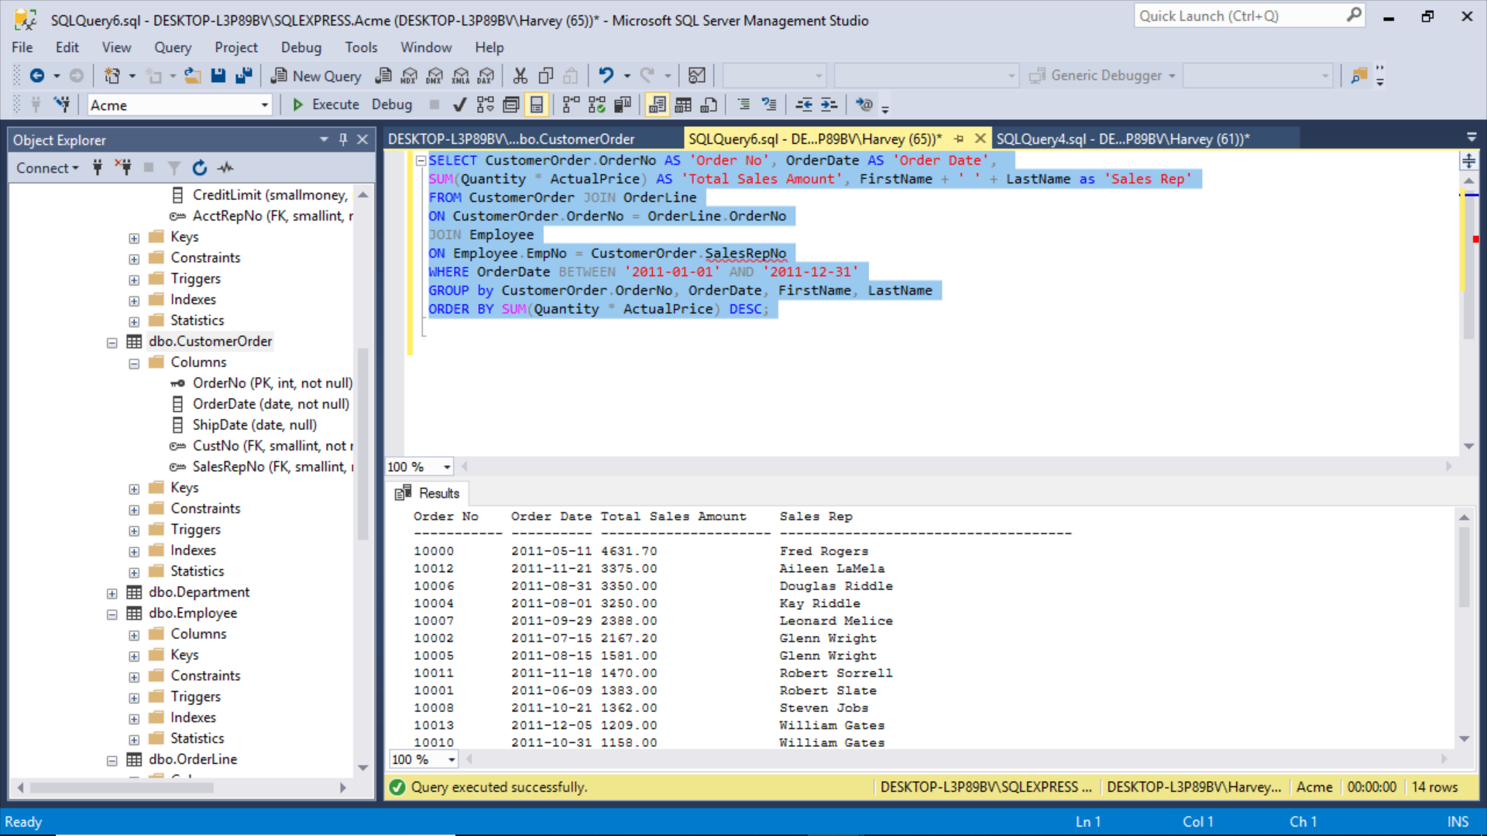
And the JOIN worked!

Slide 15
Here is the crazy SQL for you to try out yourself
SELECT CustomerOrder.OrderNo AS 'Order No', OrderDate AS 'Order Date',
SUM(Quantity * ActualPrice) AS 'Total Sales Amount', FirstName + ' ' + LastName as 'Sales Rep'
FROM CustomerOrder JOIN OrderLine
ON CustomerOrder.OrderNo = OrderLine.OrderNo
JOIN Employee
ON Employee.EmpNo = CustomerOrder.SalesRepNo
WHERE OrderDate BETWEEN '2011-01-01' AND '2011-12-31'
GROUP by CustomerOrder.OrderNo, OrderDate, FirstName, LastName
ORDER BY SUM(Quantity * ActualPrice) DESC;

Slide 16
Scenario Three:
Give me all order dates and ship dates for each Sales Rep and list them in alphabetical order by Rep’s last name.
Sometimes you just have to use trial and error to get the right SQL to answer your question:
select CustomerOrder.OrderDate, CustomerOrder.ShipDate, Employee.LastName + ', ' + FirstName as 'AccountRep' from CustomerOrder
JOIN Employee
ON EmpNo = CustomerOrder.SalesRepNo
JOIN Customer
ON AcctRepNo = EmpNo
Order by LastName

Slide 17
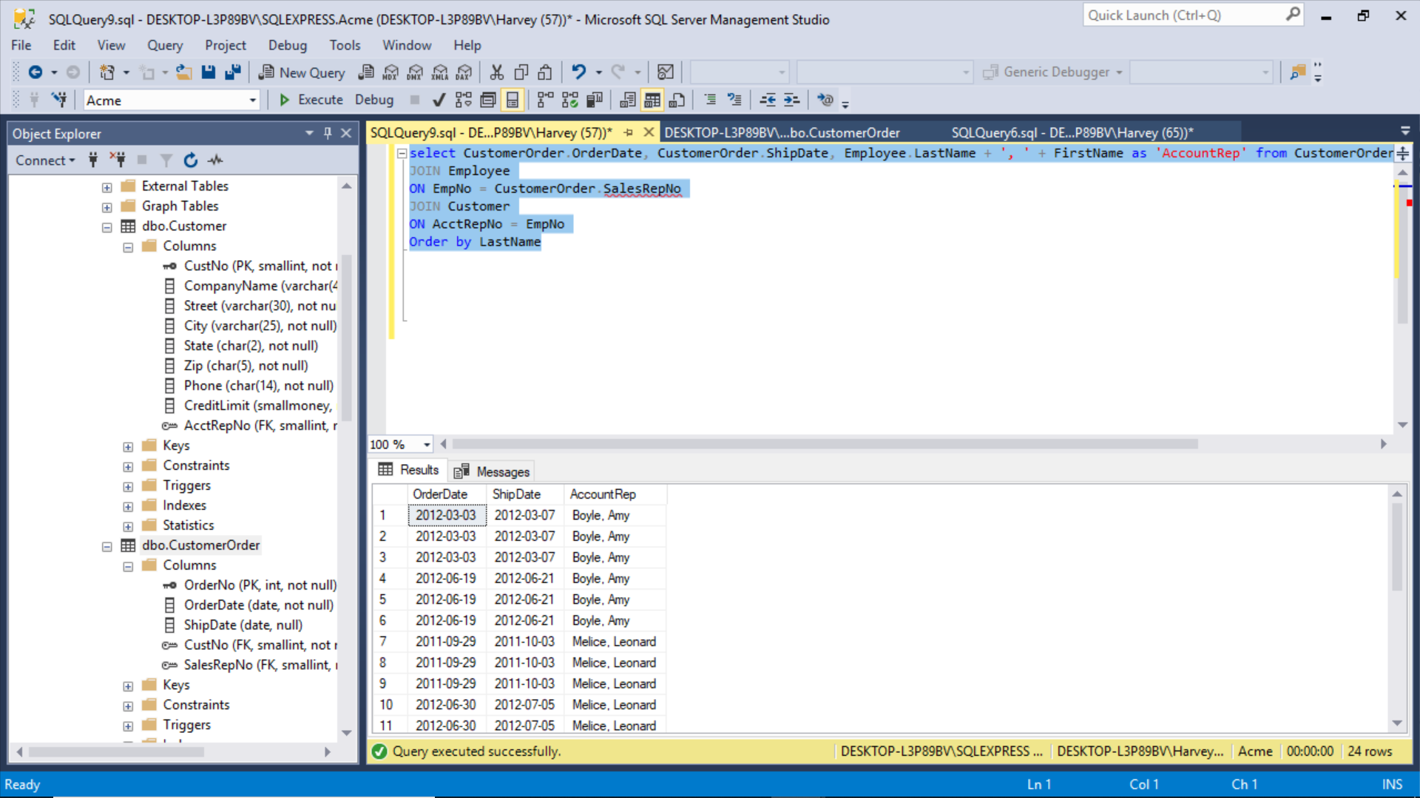

Slide 18
Scenario Four:
I want to know which Sales reps have the worst lag times between order and shipping dates. Make a list of all the Sales Reps with their orders and shipping dates, and the lag times between dates.
I want to know the lag times from highest to lowest, by order date and Sales Rep.

Slide 19
Making use of the “DATEDIFF” command
select CustomerOrder.OrderDate, CustomerOrder.ShipDate, DATEDIFF (day, OrderDate, ShipDate) AS 'Lag Time',
Employee.LastName + ', ' + FirstName as 'AccountRep' from CustomerOrder
JOIN Employee
ON employee.EmpNo = CustomerOrder.SalesRepNo
JOIN Customer
ON AcctRepNo = EmpNo
Order by DATEDIFF(day, OrderDate, ShipDate) DESC, LastName, OrderDate

Slide 20
